Slide 1
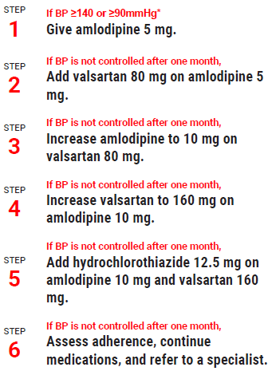
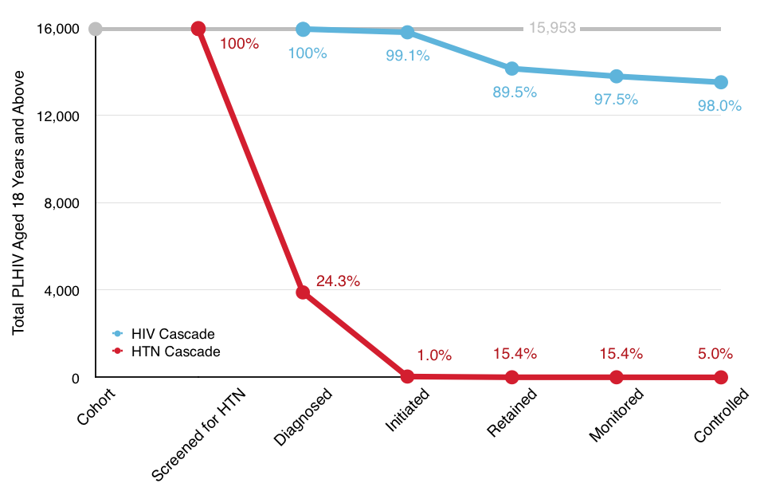
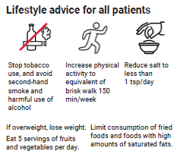
World Health Organization HEARTS Treatment protocol facilitates integration of hypertension management into HIV care and improves blood pressure control at a large HIV clinic in Uganda
Martin Muddu1, Isaac Kimera1, Rebecca Ssennyonjo1, Godwin Kamya1, Sheila Kemigisha1, Mary Mbuliro1, Rodgers Katwesigye1, Jennifer Nansubuga1, Simon P. Kigozi5, Moses R. Kamya2,5, Isaac Ssinabulya2,4, Jeremy I. Schwartz3 and Fred C. Semitala1,2,5
1Makerere University Joint AIDS Program, 2Department of Medicine, Makerere University College of Health Sciences, 3Yale School of Medicine, USA, 4Uganda Heart Institute, 5Infectious Disease Research Collaboration
Key outcomes at six months
Over 16,500 (100%) PLHIV screened for HTN
Prevalence of HTN among PLHIV is 24.3%
Both ART and HTN medicines are provided at no cost to patients
Conclusions/next steps
Simple stepwise HTN treatment protocol is effective
Access to anti-hypertensive medicines is necessary
High quality HIV care was sustained despite the integration
Expansion HTN/HIV integration is recommended
Acknowledgement
Research reported in this publication was funded by Resolve to Save Lives and the National Institutes of Health (D43 TW010037). The content is solely the responsibility of the authors and does not necessarily represent the official views of Resolve to Save Lives or the NIH.
Background
Persons Living with HIV (PLHIV) on antiretroviral therapy (ART) are at risk of hypertension (HTN);
Integration of HTN and HIV care is recommended in Uganda, but has lagged behind HIV care ;
The Mulago Immune suppression (Mulago ISS) clinic , an HIV Center of Excellence which provides care to 17,000 PLHIV under the Makerere University Joint AIDS Program (MJAP), has achieved the UNAIDS 90-90-90 goals.
However, gaps in HTN care still exist in HIV clinics even at MJAP’s center of excellence;
Figure 1: Integrated HTN & HIV care cascades at MJAP’s HIV center of excellence (Baseline);
Percentages of participants at each particular step of the cascade are compared to the previous cascade steps as denominators.
Objective:
To integrate screening and treatment of HTN into HIV care at Mulago ISS clinic in Kampala, Uganda.
Description
Table 1. Hypertension care cascade at six months
Cascade indicator | Achieved | % against target
Screened for HTN | 15,953 | 100%
Diagnosed | 1713 | 100%
Started treatment | 1133 | 66.1%
Retained at six months | 1086 | 96%
Hypertension control | 886 | 78%
Table 2. HIV care cascade during HTN/HIV integration
Cascade indicator | Achieved | % against target
Tested for HIV (Jan-Mar, 2020) | 2094 | 83%
Diagnosed | 124 | 6% (Positivity)
Start treatment | 215 | 97%
Retained at 1 year | 16428 | 90%
Controlled (viral suppression) | 17909 | 96%

